Slide 1
SPM
VII.3

Slide 2
Risk Management Process
Risk Management
Risk Identification
Risk Analysis
Risk Probability
Risk Impact
Risk factor
Risk Mitigation
Risk Avoidance
Risk Monitoring
Contingency Planning

Slide 3
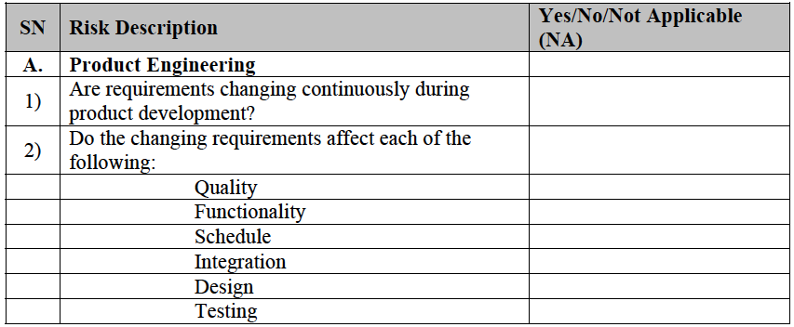
Risk Questionaire

Slide 4
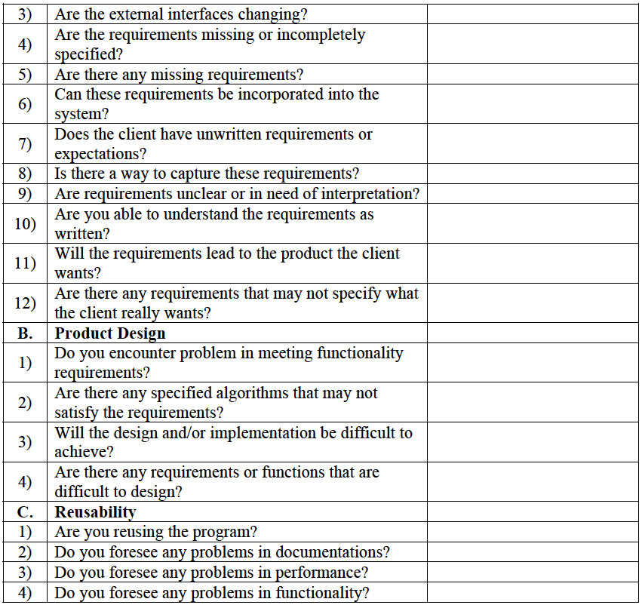

Slide 5
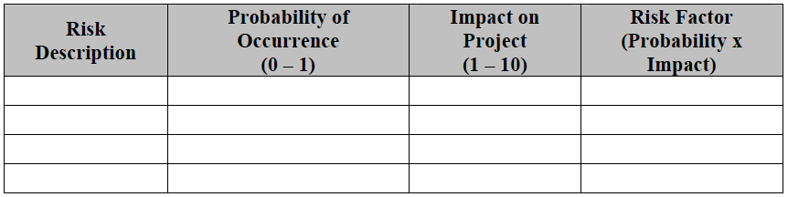
Risk Analysis

Slide 6
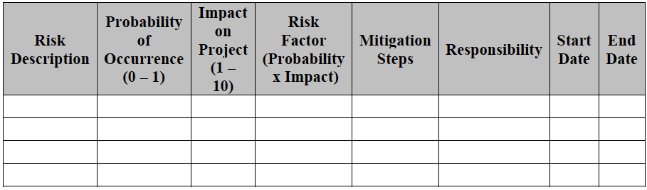
Risk Management Plan

Slide 7
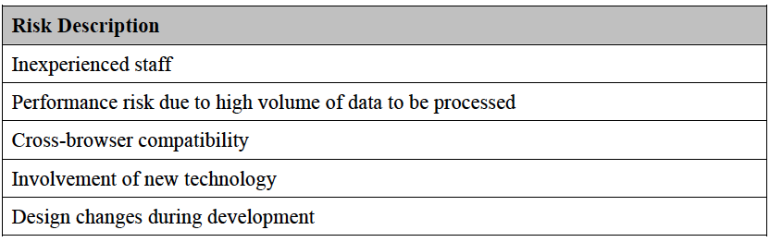
Potential Risk to a Project

